Slide 1
Decrease and Conquer
Unit 3

Slide 2
Decrease and Conquer – The IDEA
The Decrease and Conquer algorithm design strategy is based on exploiting the relationship between a solution to a given instance of a problem and a solution to its smaller instance.
The general methodology used by this design technique is as follows:
Reduce problem instance to smaller instance of the same problem
Solve smaller instance
Extend solution of smaller instance to obtain solution to original instance
Notes:
How presentation will benefit audience: Adult learners are more interested in a subject if they know how or why it is important to them.
Presenter’s level of expertise in the subject: Briefly state your credentials in this area, or explain why participants should listen to you.

Slide 3
Decrease and Conquer – The IDEA
The solution to a problem using this design strategy can be implemented either bottom – up or top – down.
This technique is also referred to as Inductive Approach or Incremental Approach.
Notes:
How presentation will benefit audience: Adult learners are more interested in a subject if they know how or why it is important to them.
Presenter’s level of expertise in the subject: Briefly state your credentials in this area, or explain why participants should listen to you.

Slide 4
Variations of Decrease and Conquer
Decrease by a constant
Decrease by a constant factor
Variable Size Decrease
Notes:
Lesson descriptions should be brief.

Slide 5
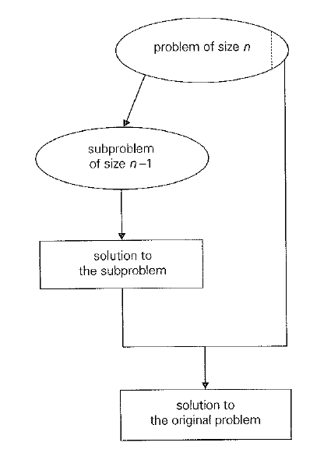
Decrease by a constant
In this variation, the size of an instance is reduced by the same constant on each iteration of the algorithm.
Typically, this constant is equal to one although other constant size reductions do happen.
Example: a^{n} = a^{n-1} * a
Notes:
Lesson descriptions should be brief.

Slide 6
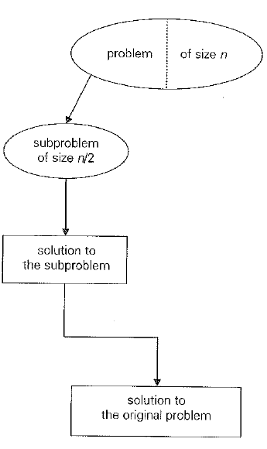
Decrease by a constant factor
In this variation, the size of an instance is reduced by the same constant factor on each iteration of the algorithm.
In most cases, this constant factor is equal to two.
Example: a^{n} = (a^{n/2})²
Notes:
Lesson descriptions should be brief.

Slide 7
Variable Size Decrease
In this variation, the size reduction pattern varies from one iteration of the algorithm to another.
Example: Euclid’s Algorithm for computing the GCD.
gcd(m, n) = gcd (n, m mod n)
Notes:
Lesson descriptions should be brief.

Slide 8
INSERTION SORT

Slide 9
Insertion Sort – The IDEA
It is an example of the Decrease – by – One technique to sorting an array A[0..n-1].
We assume that the smaller problem of sorting an array of size,
A[0..n-2] has already been solved to give us a sorted array of size n-1: A[0] <= A[1] …. <= A[0..n-2].
Then we find an appropriate position for A[n-1] among the sorted elements and insert it there.
Notes:
How presentation will benefit audience: Adult learners are more interested in a subject if they know how or why it is important to them.
Presenter’s level of expertise in the subject: Briefly state your credentials in this area, or explain why participants should listen to you.

Slide 10
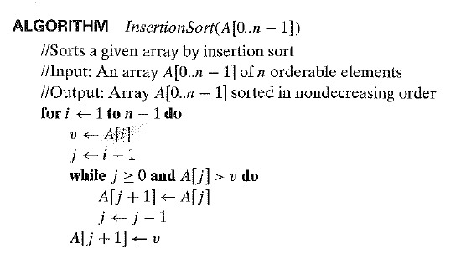
Insertion Sort – The ALGORITHM
Notes:
How presentation will benefit audience: Adult learners are more interested in a subject if they know how or why it is important to them.
Presenter’s level of expertise in the subject: Briefly state your credentials in this area, or explain why participants should listen to you.

Slide 11
Insertion Sort – An Example
6 |4 1 8 5
4 6 |1 8 5
1 4 6 |8 5
1 4 6 8 |5
1 4 5 6 8
Notes:
How presentation will benefit audience: Adult learners are more interested in a subject if they know how or why it is important to them.
Presenter’s level of expertise in the subject: Briefly state your credentials in this area, or explain why participants should listen to you.

Slide 12


Insertion Sort – Analysis
In the worst case:
In the best case:
Notes:
How presentation will benefit audience: Adult learners are more interested in a subject if they know how or why it is important to them.
Presenter’s level of expertise in the subject: Briefly state your credentials in this area, or explain why participants should listen to you.

Slide 13

Insertion Sort – Analysis
In the average case:
Notes:
How presentation will benefit audience: Adult learners are more interested in a subject if they know how or why it is important to them.
Presenter’s level of expertise in the subject: Briefly state your credentials in this area, or explain why participants should listen to you.

Slide 14
DEPTH FIRST SEARCH

Slide 15
Depth First Search – The IDEA
Visits graph’s vertices by always moving away from last visited vertex to an unvisited one, backtracks if no adjacent unvisited vertex is available.
Recursive or it uses a stack
a vertex is pushed onto the stack when it’s reached for the first time
a vertex is popped off the stack when it becomes a dead end, i.e., when there is no adjacent unvisited vertex
“Redraws” graph in tree-like fashion (with tree edges and back edges for undirected graph)
Notes:
How presentation will benefit audience: Adult learners are more interested in a subject if they know how or why it is important to them.
Presenter’s level of expertise in the subject: Briefly state your credentials in this area, or explain why participants should listen to you.

Slide 16
Depth First Search – The IDEA
It is useful to accompany a DFS traversal by constructing the Depth First Search Forest.
The starting vertex of the traversal serves as the root of the first tree in such a forest.
Whenever a new unvisited vertex is reached for the first time, it is attached as a child to the vertex from which it is being reached. Such an edge is called a tree edge because the set of all such edges forms a forest.
The algorithm may also encounter an edge leading to a previously visited vertex other than its immediate predecessor. Such an edge is called a back edge because it connects a vertex to its ancestor, other than the parent, in the depth-first search forest.
Notes:
How presentation will benefit audience: Adult learners are more interested in a subject if they know how or why it is important to them.
Presenter’s level of expertise in the subject: Briefly state your credentials in this area, or explain why participants should listen to you.

Slide 17
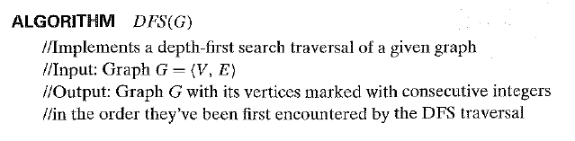
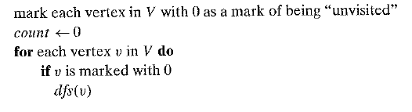
Depth First Search – The ALGORITHM
Notes:
How presentation will benefit audience: Adult learners are more interested in a subject if they know how or why it is important to them.
Presenter’s level of expertise in the subject: Briefly state your credentials in this area, or explain why participants should listen to you.

Slide 18
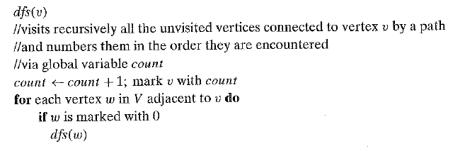
Depth First Search – The ALGORITHM
Notes:
How presentation will benefit audience: Adult learners are more interested in a subject if they know how or why it is important to them.
Presenter’s level of expertise in the subject: Briefly state your credentials in this area, or explain why participants should listen to you.

Slide 19
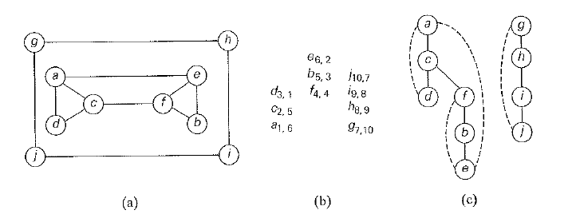
Depth First Search – An Example
Graph
Stack
Forest
Notes:
How presentation will benefit audience: Adult learners are more interested in a subject if they know how or why it is important to them.
Presenter’s level of expertise in the subject: Briefly state your credentials in this area, or explain why participants should listen to you.

Slide 20
Depth First Search – Analysis
DFS can be implemented using Adjacency Lists and Adjacency Matrices.
The efficiency is as follows:
adjacency matrices: Θ(|V|²).
adjacency lists: Θ(|V|+|E|).
Notes:
How presentation will benefit audience: Adult learners are more interested in a subject if they know how or why it is important to them.
Presenter’s level of expertise in the subject: Briefly state your credentials in this area, or explain why participants should listen to you.

Slide 21
BREADTH FIRST SEARCH

Slide 22
Breadth First Search – The IDEA
Visits graph vertices by moving across to all the neighbors of the last visited vertex
Instead of a stack, BFS uses a queue
Similar to level-by-level tree traversal
“Redraws” graph in tree-like fashion (with tree edges and cross edges for undirected graph)
Notes:
How presentation will benefit audience: Adult learners are more interested in a subject if they know how or why it is important to them.
Presenter’s level of expertise in the subject: Briefly state your credentials in this area, or explain why participants should listen to you.

Slide 23
Breadth First Search – The IDEA
It is useful to accompany a BFS traversal by constructing the so-called breadth-first search forest.
The traversal's starting vertex serves as the root of the first tree in such a forest.
Whenever a new unvisited vertex is reached for the first time, the vertex is attached as a child to the vertex it is being reached from with an edge called a tree edge.
If an edge leading to a previously visited vertex other than its immediate predecessor (i.e., its parent in the tree) is encountered, the edge is noted as a cross edge.
Notes:
How presentation will benefit audience: Adult learners are more interested in a subject if they know how or why it is important to them.
Presenter’s level of expertise in the subject: Briefly state your credentials in this area, or explain why participants should listen to you.

Slide 24
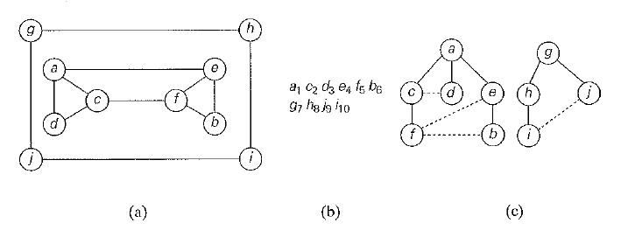
Breadth First Search – An Example
Graph
Stack
Forest
Notes:
How presentation will benefit audience: Adult learners are more interested in a subject if they know how or why it is important to them.
Presenter’s level of expertise in the subject: Briefly state your credentials in this area, or explain why participants should listen to you.

Slide 25
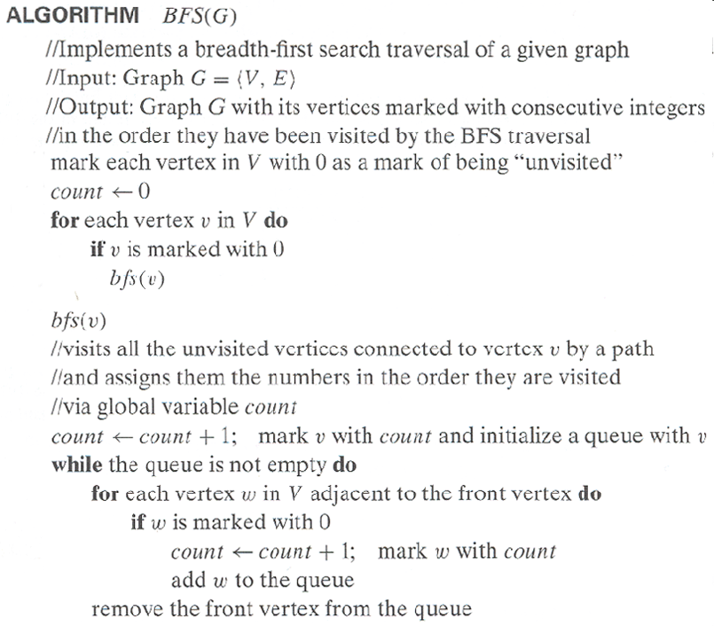
Breadth First Search – The ALGORITHM
Notes:
How presentation will benefit audience: Adult learners are more interested in a subject if they know how or why it is important to them.
Presenter’s level of expertise in the subject: Briefly state your credentials in this area, or explain why participants should listen to you.

Slide 26
Breadth First Search – The ALGORITHM
Notes:
How presentation will benefit audience: Adult learners are more interested in a subject if they know how or why it is important to them.
Presenter’s level of expertise in the subject: Briefly state your credentials in this area, or explain why participants should listen to you.

Slide 27
Breadth First Search – Analysis
BFS can be implemented using Adjacency Lists and Adjacency Matrices.
The efficiency is as follows:
adjacency matrices: Θ(|V|²).
adjacency lists: Θ(|V|+|E|).
BFS has the same efficiency as DFS.
Notes:
How presentation will benefit audience: Adult learners are more interested in a subject if they know how or why it is important to them.
Presenter’s level of expertise in the subject: Briefly state your credentials in this area, or explain why participants should listen to you.

Slide 28
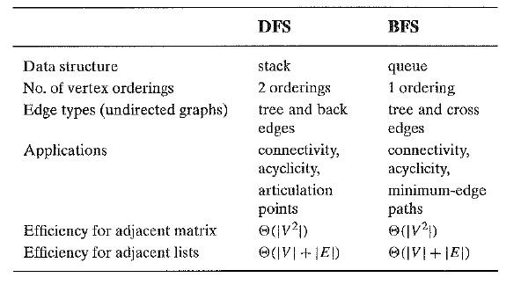
BFS Vs DFS
Notes:
How presentation will benefit audience: Adult learners are more interested in a subject if they know how or why it is important to them.
Presenter’s level of expertise in the subject: Briefly state your credentials in this area, or explain why participants should listen to you.

Slide 29
Depth First Search – Applications
Checking connectivity, finding connected components
Checking acyclicity (if no back edges)
Finding articulation points and biconnected components
Searching the state-space of problems for solutions (in AI)
Notes:
How presentation will benefit audience: Adult learners are more interested in a subject if they know how or why it is important to them.
Presenter’s level of expertise in the subject: Briefly state your credentials in this area, or explain why participants should listen to you.

Slide 30
Breadth First Search – Applications
Checking connectivity, finding connected components
Checking acyclicity
Searching the state-space of problems for solutions (in AI)
can also find paths from a vertex to all other vertices with the smallest number of edges
Notes:
How presentation will benefit audience: Adult learners are more interested in a subject if they know how or why it is important to them.
Presenter’s level of expertise in the subject: Briefly state your credentials in this area, or explain why participants should listen to you.

Slide 31
TOPOLOGICAL SORTING

Slide 32
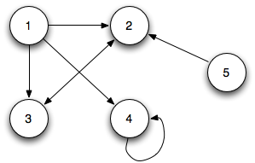
Facts about Directed Graphs
A Directed Graph or digraph is a graph with directions specified for its edges.
The edges indicate a one-way relationship, in that each edge can only be traversed in a single direction.
The adjacency matrix and the adjacency list are the two principal ways of representing a digraph as well.
Differences between directed graphs and undirected graphs:
The adjacency matrix does not have to be symmetric for a digraph.
An edge in a digraph has just one corresponding node in the adjacency list
Notes:
How presentation will benefit audience: Adult learners are more interested in a subject if they know how or why it is important to them.
Presenter’s level of expertise in the subject: Briefly state your credentials in this area, or explain why participants should listen to you.

Slide 33
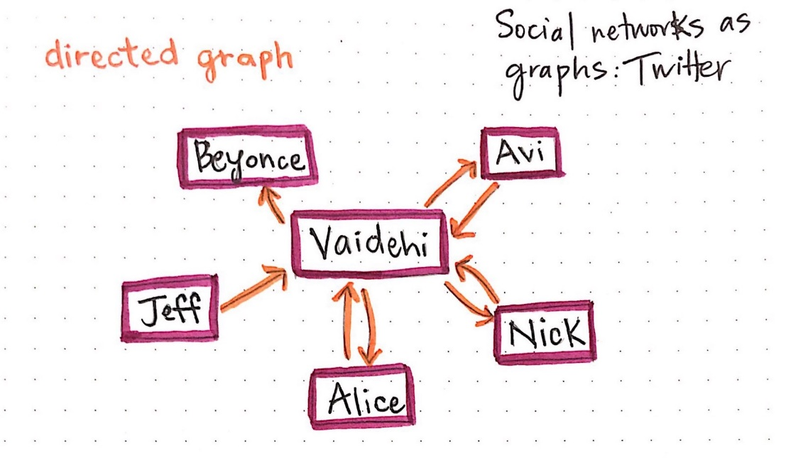
Directed Acyclic Graph
Twitter can be represented as a directed graph.
Person A can follow Person B but this need not be vice – versa.
A directed cycle in a digraph is a sequence of three or more of its vertices that starts and ends with the same vertex.
Example: Vaidehi -> Alice -> Vaidehi
A directed graph with no cycles is a Directed Acyclic Graph (DAG).
Notes:
How presentation will benefit audience: Adult learners are more interested in a subject if they know how or why it is important to them.
Presenter’s level of expertise in the subject: Briefly state your credentials in this area, or explain why participants should listen to you.

Slide 34
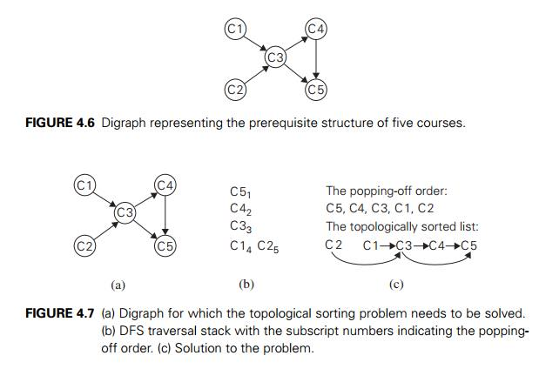
Topological Sorting – The Problem
Consider a set of five required courses {C1, C2, C3, C4, C5} a part – time student has to take in some degree program.
The courses can be taken in any order as long as the following pre – requisites are met:
C1 and C2 – No Pre – Requisites
C3 – Requires C1 and C2
C4 – Requires C3
C5 – Requires C4 and C5
The student can take only one course per term.
In which order should the student take the courses?
Notes:
How presentation will benefit audience: Adult learners are more interested in a subject if they know how or why it is important to them.
Presenter’s level of expertise in the subject: Briefly state your credentials in this area, or explain why participants should listen to you.

Slide 35
Topological Sorting – The Problem
If this situation is modeled as a digraph, the problem is can we list the vertices in such an order that, for every edge in the digraph, the vertex where the edge starts is listed before the vertex where the edge ends?
Notes:
How presentation will benefit audience: Adult learners are more interested in a subject if they know how or why it is important to them.
Presenter’s level of expertise in the subject: Briefly state your credentials in this area, or explain why participants should listen to you.

Slide 36
Topological Sorting – The Problem
If this situation is modeled as a digraph, the problem is can we list the vertices in such an order that, for every edge in the digraph, the vertex where the edge starts is listed before the vertex where the edge ends?
This problem cannot have a solution if the graph is a Directed Acyclic Graph.
Notes:
How presentation will benefit audience: Adult learners are more interested in a subject if they know how or why it is important to them.
Presenter’s level of expertise in the subject: Briefly state your credentials in this area, or explain why participants should listen to you.

Slide 37
Topological Sorting – Algorithm 1
Perform a DFS traversal.
Note the order in which vertices become dead – ends (popped out of the traversal stack).
Reversing this order yields a solution to the problem.
Consider the following example:
Notes:
How presentation will benefit audience: Adult learners are more interested in a subject if they know how or why it is important to them.
Presenter’s level of expertise in the subject: Briefly state your credentials in this area, or explain why participants should listen to you.

Slide 38
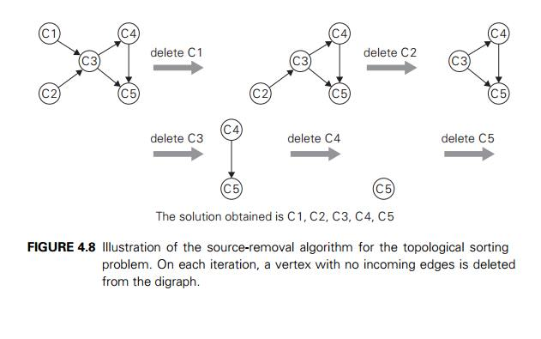
Topological Sorting – Algorithm 2
Identify in a remaining digraph a source vertex: A vertex which has no incoming edges.
Delete this source vertex along with all outgoing edges
Consider the following example:
Notes:
How presentation will benefit audience: Adult learners are more interested in a subject if they know how or why it is important to them.
Presenter’s level of expertise in the subject: Briefly state your credentials in this area, or explain why participants should listen to you.

Slide 39
ALGORITHMS FOR GENERATING COMBINATORIAL OBJECTS

Slide 40
GENERATING PERMUTATIONS
Assumption:
The set of elements that need to be permuted is simply the set of integers from 1 to n.
You can interpret this as the indices of elements in an n – element set
{a₁, a₂, …, a_{n}}.
Question:
What is the decrease – by – one technique to solve the problem of generating all n! permutations of the set {1, 2, 3, …., n}?
Notes:
How presentation will benefit audience: Adult learners are more interested in a subject if they know how or why it is important to them.
Presenter’s level of expertise in the subject: Briefly state your credentials in this area, or explain why participants should listen to you.

Slide 41
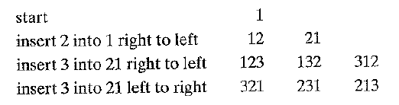
GENERATING PERMUTATIONS
Answer:
Generate all the (n-1)! permutations.
Assuming that the smaller problem is solved, the problem of generating n! permutations can be obtained by inserting n in each of the n positions of every permutation of n – 1 elements.
Now, try for n = 4.
Notes:
How presentation will benefit audience: Adult learners are more interested in a subject if they know how or why it is important to them.
Presenter’s level of expertise in the subject: Briefly state your credentials in this area, or explain why participants should listen to you.

Slide 42
GENERATING PERMUTATIONS
All the permutations generated in this fashion will be distinct. Why?
The total number of permutations will be n(n-1)! How?
Continuing the algorithm, n can be inserted in the previously generated permutations starting from either left to right or right to left.
It is beneficial to start from right to left and switch direction every time a new permutation of (n – 1) needs to be processed.
Following this, each permutation can be obtained from its immediate predecessor just by changing two elements in it. This satisfies the minimal change requirement.
Notes:
How presentation will benefit audience: Adult learners are more interested in a subject if they know how or why it is important to them.
Presenter’s level of expertise in the subject: Briefly state your credentials in this area, or explain why participants should listen to you.

Slide 43

GENERATING PERMUTATIONS – JOHNSON TROTTER ALGORITHM
It is possible to get the permutations of n elements without explicitly generating the permutations of n – 1 elements.
This can be done by associating a direction with each element k in a permutation.
The direction is indicated by a small arrow written above the element in question.
Mobile Element: The element k is said to be mobile in such an arrow marked representation if its arrow is pointing to a smaller number adjacent to it.
Notes:
How presentation will benefit audience: Adult learners are more interested in a subject if they know how or why it is important to them.
Presenter’s level of expertise in the subject: Briefly state your credentials in this area, or explain why participants should listen to you.

Slide 44
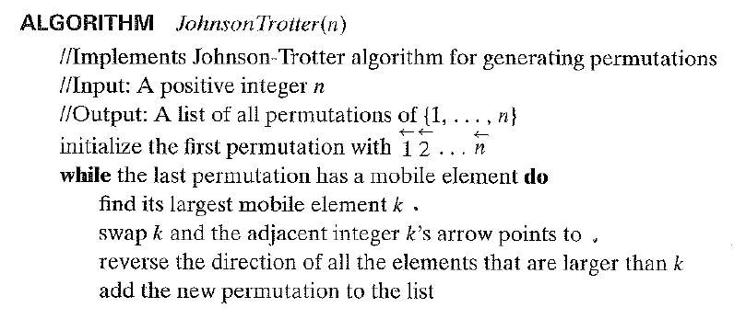
GENERATING PERMUTATIONS – JOHNSON TROTTER ALGORITHM
Notes:
How presentation will benefit audience: Adult learners are more interested in a subject if they know how or why it is important to them.
Presenter’s level of expertise in the subject: Briefly state your credentials in this area, or explain why participants should listen to you.

Slide 45

GENERATING PERMUTATIONS – JOHNSON TROTTER ALGORITHM
Example:
n = 3
Notes:
How presentation will benefit audience: Adult learners are more interested in a subject if they know how or why it is important to them.
Presenter’s level of expertise in the subject: Briefly state your credentials in this area, or explain why participants should listen to you.

Slide 46
GENERATING PERMUTATIONS – JOHNSON TROTTER ALGORITHM
This algorithm is one of the most efficient for generating permutations.
Its runtime belongs to (n!).
It is very slow except for very small values of n.
But this is the fault of the problem.
Notes:
How presentation will benefit audience: Adult learners are more interested in a subject if they know how or why it is important to them.
Presenter’s level of expertise in the subject: Briefly state your credentials in this area, or explain why participants should listen to you.

Slide 47
GENERATING PERMUTATIONS – LEXICOGRAPHIC ORDER
The permutations generated by Johnson – Trotter algorithm are not in lexicographic order.
The order in which they would appear in a dictionary if they were interpreted as letters of an alphabet.
So, what does this algorithm say?
Notes:
How presentation will benefit audience: Adult learners are more interested in a subject if they know how or why it is important to them.
Presenter’s level of expertise in the subject: Briefly state your credentials in this area, or explain why participants should listen to you.

Slide 48
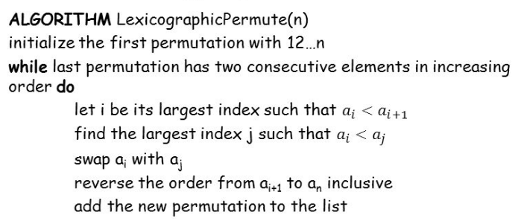
GENERATING PERMUTATIONS – LEXICOGRAPHIC ORDER
//a_{i+1} > a_{i+2} > …. > a_{n}
//j >= i+1 since a_{i} < a_{i+1}
//a_{i+1} a_{i+2} … a_{n} will remain in decreasing order
Notes:
How presentation will benefit audience: Adult learners are more interested in a subject if they know how or why it is important to them.
Presenter’s level of expertise in the subject: Briefly state your credentials in this area, or explain why participants should listen to you.

Slide 49
GENERATING SUBSETS

Slide 50
THE KNAPSACK PROBLEM
Problem:
Find the most valuable subset of a given set of items which fits in a knapsack with a particular capacity.
Solution:
Generate all subsets of the given set of items, determine the value of each subset and pick the most valuable subset.
This section discusses algorithms for generating all the subsets of a given set.
Notes:
How presentation will benefit audience: Adult learners are more interested in a subject if they know how or why it is important to them.
Presenter’s level of expertise in the subject: Briefly state your credentials in this area, or explain why participants should listen to you.

Slide 51
THE DECREASE – BY – ONE STRATEGY
All the subsets of set A = {a₁, a₂, a₃, . . . ., a_{n}}
=
All the subsets of the set {a₁, a₂, a₃, . . . ., a_{n-1}} + sets obtained by putting an in each one of the subsets of {a₁, a₂, a₃, . . . ., a_{n-1}}
n | Subsets
0 | 
1 |  | {a₁}
2 |  | {a₁} | {a₂} | {a₁, a₂}
3 |  | {a₁} | {a₂} | {a₁, a₂} | {a₃} | {a₁, a₃} | {a₂, a₃} | {a₁, a₂, a₃}
Notes:
How presentation will benefit audience: Adult learners are more interested in a subject if they know how or why it is important to them.
Presenter’s level of expertise in the subject: Briefly state your credentials in this area, or explain why participants should listen to you.

Slide 52
AN ALTERNATIVE SOLUTION
The subset generation problem can be solved by establishing correspondence between subsets of an n – element set {a₁, a₂, a₃, . . . ., a_{n}} and all 2^{n} bit strings of length n.
Thus, if every bit string of length n is generated, it solves the subset generation problem.
Bit Strings | 000 | 001 | 010 | 011 | 100 | 101 | 110 | 111
Subsets |  | {a₃} | {a₂} | {a₂, a₃} | {a₁} | {a₁, a₃} | {a₁, a₂} | {a₁, a₂, a₃}
Notes:
How presentation will benefit audience: Adult learners are more interested in a subject if they know how or why it is important to them.
Presenter’s level of expertise in the subject: Briefly state your credentials in this area, or explain why participants should listen to you.

Slide 53
BINARY REFLECTED GRAY CODE
Is there an algorithm which generates bit strings with minimal change in the bits? That is, from one bit string to the next there is change in just one bit?
The above sequence of code is called the Binary Reflected Gray Code.
000 | 001 | 011 | 010 | 110 | 111 | 101 | 100
Notes:
How presentation will benefit audience: Adult learners are more interested in a subject if they know how or why it is important to them.
Presenter’s level of expertise in the subject: Briefly state your credentials in this area, or explain why participants should listen to you.

Slide 54
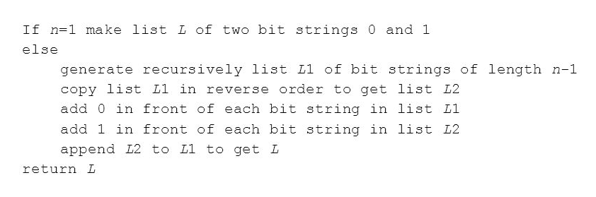
BINARY REFLECTED GRAY CODE
The algorithm to generate Binary Reflected Gray Code is as follows:
Notes:
How presentation will benefit audience: Adult learners are more interested in a subject if they know how or why it is important to them.
Presenter’s level of expertise in the subject: Briefly state your credentials in this area, or explain why participants should listen to you.

Slide 55
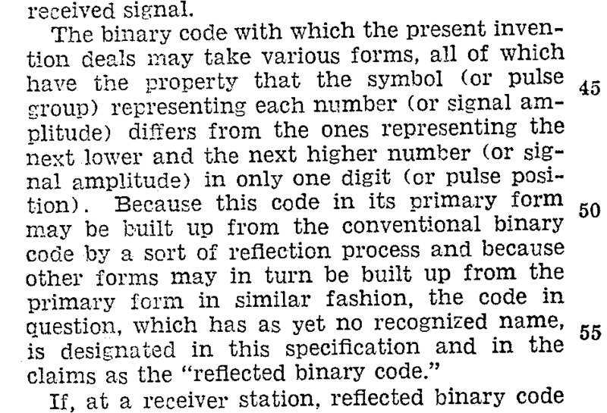
BINARY REFLECTED GRAY CODE – A Pinch of History
Frank Gray, after which the code is named, was a researcher in the AT & T Bell Labs. This code was reinvented to minimize the effect of errors in transmitting signals.
Seventy years earlier, this was used by French Engineer Emile Baudot in telegraphy.
Picture of the patent which introduces the term.
Notes:
How presentation will benefit audience: Adult learners are more interested in a subject if they know how or why it is important to them.
Presenter’s level of expertise in the subject: Briefly state your credentials in this area, or explain why participants should listen to you.

Slide 56
QUESTION
The bit string solution does not generate subsets in squashed order.
Squashed Order: Any subset involving a_{j} can be listed only after all the subsets involving a₁, a₂, …., a_{j-1} are listed.
How to generate all the subsets of a set in squashed order?
Notes:
How presentation will benefit audience: Adult learners are more interested in a subject if they know how or why it is important to them.
Presenter’s level of expertise in the subject: Briefly state your credentials in this area, or explain why participants should listen to you.

Slide 57
DECREASE BY A CONSTANT FACTOR

Slide 58
FAKE – COIN PROBLEM

Slide 59

THE PROBLEM
Among n identical looking coins, one is fake. The fake coin is known to be lighter than a genuine one. How do you identify the fake coin?
Notes:
How presentation will benefit audience: Adult learners are more interested in a subject if they know how or why it is important to them.
Presenter’s level of expertise in the subject: Briefly state your credentials in this area, or explain why participants should listen to you.

Slide 60
THE SOLUTION
The solution to the problem involves dividing the n coins into two piles of floor(n/2) each. If there are odd number of coins, one is left outside.
If the piles weigh the same, the coin put aside is the fake coin.
Otherwise, we can proceed in the same manner with the lighter pile, which must contain the fake coin.
The number of weighings W(n) needed by the algorithm in the worst case:
Recurrence: W(n) = W(floor(n/2)) + 1 for n > 1, W(1) = 0
Notes:
How presentation will benefit audience: Adult learners are more interested in a subject if they know how or why it is important to them.
Presenter’s level of expertise in the subject: Briefly state your credentials in this area, or explain why participants should listen to you.

Slide 61
THE SOLUTION
This recurrence is similar to the recurrence set up by Binary Search.
Thus, the algorithm takes └ log2n ┘ number of weighings.
Notes:
How presentation will benefit audience: Adult learners are more interested in a subject if they know how or why it is important to them.
Presenter’s level of expertise in the subject: Briefly state your credentials in this area, or explain why participants should listen to you.

Slide 62
RUSSIAN PEASANT MULTIPLICATION

Slide 63
THE RUSSIAN PEASANT MULTIPLICATION
The Russian Peasant multiplication or multiplication a la russe is a non – orthodox algorithm for multiplying two positive integers n and m.
If the instance size is measured by n, then we reduce the instance into half, i.e, into n/2 as follows:
n * m = (n/2) * 2m (when n is even)
n * m = [(n – 1) * 2m + m] (when n is odd)
Notes:
How presentation will benefit audience: Adult learners are more interested in a subject if they know how or why it is important to them.
Presenter’s level of expertise in the subject: Briefly state your credentials in this area, or explain why participants should listen to you.

Slide 64
THE RUSSIAN PEASANT MULTIPLICATION
The Russian Peasant multiplication or multiplication a la russe is a non – orthodox algorithm for multiplying two positive integers n and m.
If the instance size is measured by n, then we reduce the instance into half, i.e, into n/2 as follows:
n * m = (n/2) * 2m (when n is even)
n * m = [(n – 1) * 2m + m] (when n is odd)
Notes:
How presentation will benefit audience: Adult learners are more interested in a subject if they know how or why it is important to them.
Presenter’s level of expertise in the subject: Briefly state your credentials in this area, or explain why participants should listen to you.

Slide 65
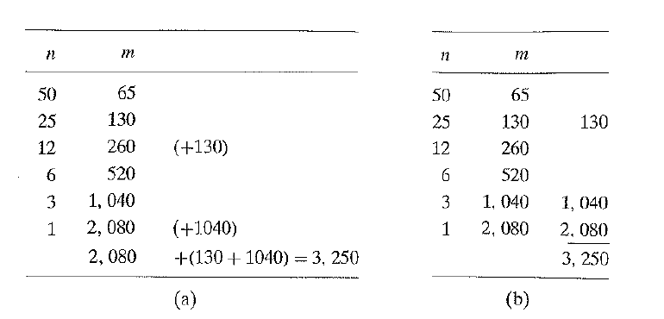
THE RUSSIAN PEASANT MULTIPLICATION - EXAMPLE
Notes:
How presentation will benefit audience: Adult learners are more interested in a subject if they know how or why it is important to them.
Presenter’s level of expertise in the subject: Briefly state your credentials in this area, or explain why participants should listen to you.

Slide 66
THE RUSSIAN PEASANT MULTIPLICATION
In figure (a), we can see that the extra addends are in the rows that have odd values in the first column.
Thus in figure (b), we can find the product by simply adding the elements in the m column that have an odd number in the n column.
This method leads to fast hardware implementations since doubling and halving of binary numbers can be achieved by shifts.
Notes:
How presentation will benefit audience: Adult learners are more interested in a subject if they know how or why it is important to them.
Presenter’s level of expertise in the subject: Briefly state your credentials in this area, or explain why participants should listen to you.

